Slide 1
KYC VERIFICATION USING BLOCKCHAIN
PIP2001 Capstone Project
Review-0
Batch Number: CBC-01
Roll Number | Student Name
20211CBC0022 | Nithya Sai
20211CBC0004 | Abdul Shakir
20211CBC0009 | Akbar Basha
20211CBC0011 | Hari Teja
20211CBC0062 | Chandra Shekar
Under the Supervision of,
Dr . PRAVINTH RAJA
Associate Professor
School of Computer Science and Engineering
Presidency University
Name of the Program: CSE (Blockchain)
Name of the HoD: DR.PRAVINTH RAJA
Name of the Program Project Coordinator: SUMA N G
Name of the School Project Coordinators: Dr. Sampath A K / Dr. Abdul Khadar A / Mr. Md Ziaur Rahman

Slide 2
Content
Problem Statement
Github Link
Analysis of Problem Statement
Timeline of the Project
References

Slide 3
Problem Statement Number: PSCS217
Organization: MindTree
Category (Hardware / Software / Both) : Software
Problem Description:
The current KYC (Know Your Customer) process often lacks control over the amount of personal data shared with agencies, posing privacy and security risks. To address this, we propose a solution using permissioned blockchain where users own their data, stored securely in the Hyperledger Blockchain. Through a specialized application, users can control the depth of data shared. Access to the data can be temporary or permanent, with verified users being marked as authenticated in the blockchain ledger. Access revocation can be manual enhancing security and minimizing data misuse.
For individuals without smartphones, especially uneducated or underserved populations, a digital NFC card would be provided. This card contains encrypted, unique identification information, ensuring security and preventing duplication. Agencies can use this card for verification, with access controlled by restrictions imposed by the government to protect customer data.
Difficulty Level: Medium

Slide 4
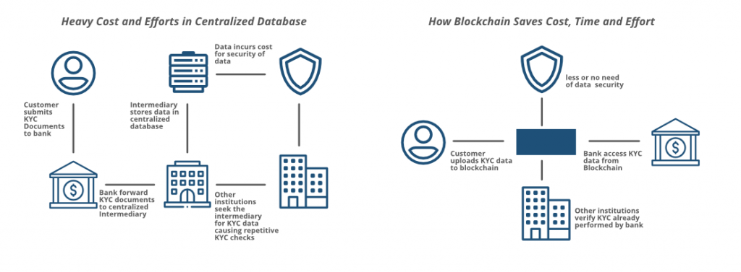
FLOW CHART

Slide 5
Github Link
https://github.com/PIPCBC-01/KYC-Verification-Using-Blockchain.git

Slide 6
Analysis of Problem Statement
Technology Stack Components:
Blockchain Platform :
Ethereum: Suitable for public, decentralized applications.
Hyperledger Fabric: Ideal for permissioned networks with controlled access.
2. Smart Contracts
Solidity (for Ethereum) or Chaincode (for Hyperledger Fabric): These are used to write smart contracts, which will handle the automation of KYC processes.
3. Development Tools:
Truffle Suite (Ethereum) for development, testing, and deployment of smart contracts.
Hyperledger Composer for writing and deploying smart contracts on Hyperledger Fabric.

Slide 7
Analysis of Problem Statement (contd...)
4. Web3 Frameworks :
Web3.js (for Ethereum) or Hyperledger SDK: These frameworks allow the frontend to interact with the blockchain.
Web3.js: Integrates Ethereum blockchain with a frontend using JavaScript.
Hyperledger Fabric SDKs: Provides APIs for integrating blockchain with applications (Node.js or Go SDK).
5. Front-end Development
React.js or Angular.js: A modern web framework to build the user interface.
Enables users and organizations to submit KYC documents and check their verification status.
6. Back-end Development
Node.js : For managing the business logic, API interactions, and serving the frontend.
Express.js (Node.js) for API management and handling backend logic.

Slide 8
Analysis of Problem Statement (contd...)
Software Requirements:
Operating System: Linux (Ubuntu preferred), macOS, or Windows
Node.js (for web3 integration and backend development).
Solidity Compiler : For compiling smart contracts.
Hyperledger Fabric binaries (for setting up a private blockchain network).

Slide 9
Timeline of the Project (Gantt Chart)
 | September |  | October |  |  |  | November |  |  |  | December
 | Week 01 | Week 02 | Week 01 | Week 02 | Week 03 | Week 04 | Week 01 | Week 02 | Week 03 | Week 04 | Week 01 | Week 02
Research
Requirement & Analysis
Smart Contract Design & Deployment
Backend Development
Frontend Development
Integration & System Testing
Deployment
Project Closeout
Data
Data
Data
Data
Data
Data
Data
Data

Slide 10
References (IEEE Paper format)
Ujwala Ravale; Aditya Ramakrishnan; Anand Borkar; Suchit Deshmukh (2023). Optimizing the KYC verification system using Ethereum blockchain.
Nafees Mansoor; Kaniz Fatema Antora; Priyata Deb; Tarek Ahammed Arman (2023). A review of blockchain approaches for KYC.
Vijay U. Rathod; Yogesh Kisan Mali; Nilesh P. Sable; Rahul Ramkishan Rathod; Manoj N Rathod (2023). The use of blockchain technology to verify KYC documents.

Slide 11


